Slide 1
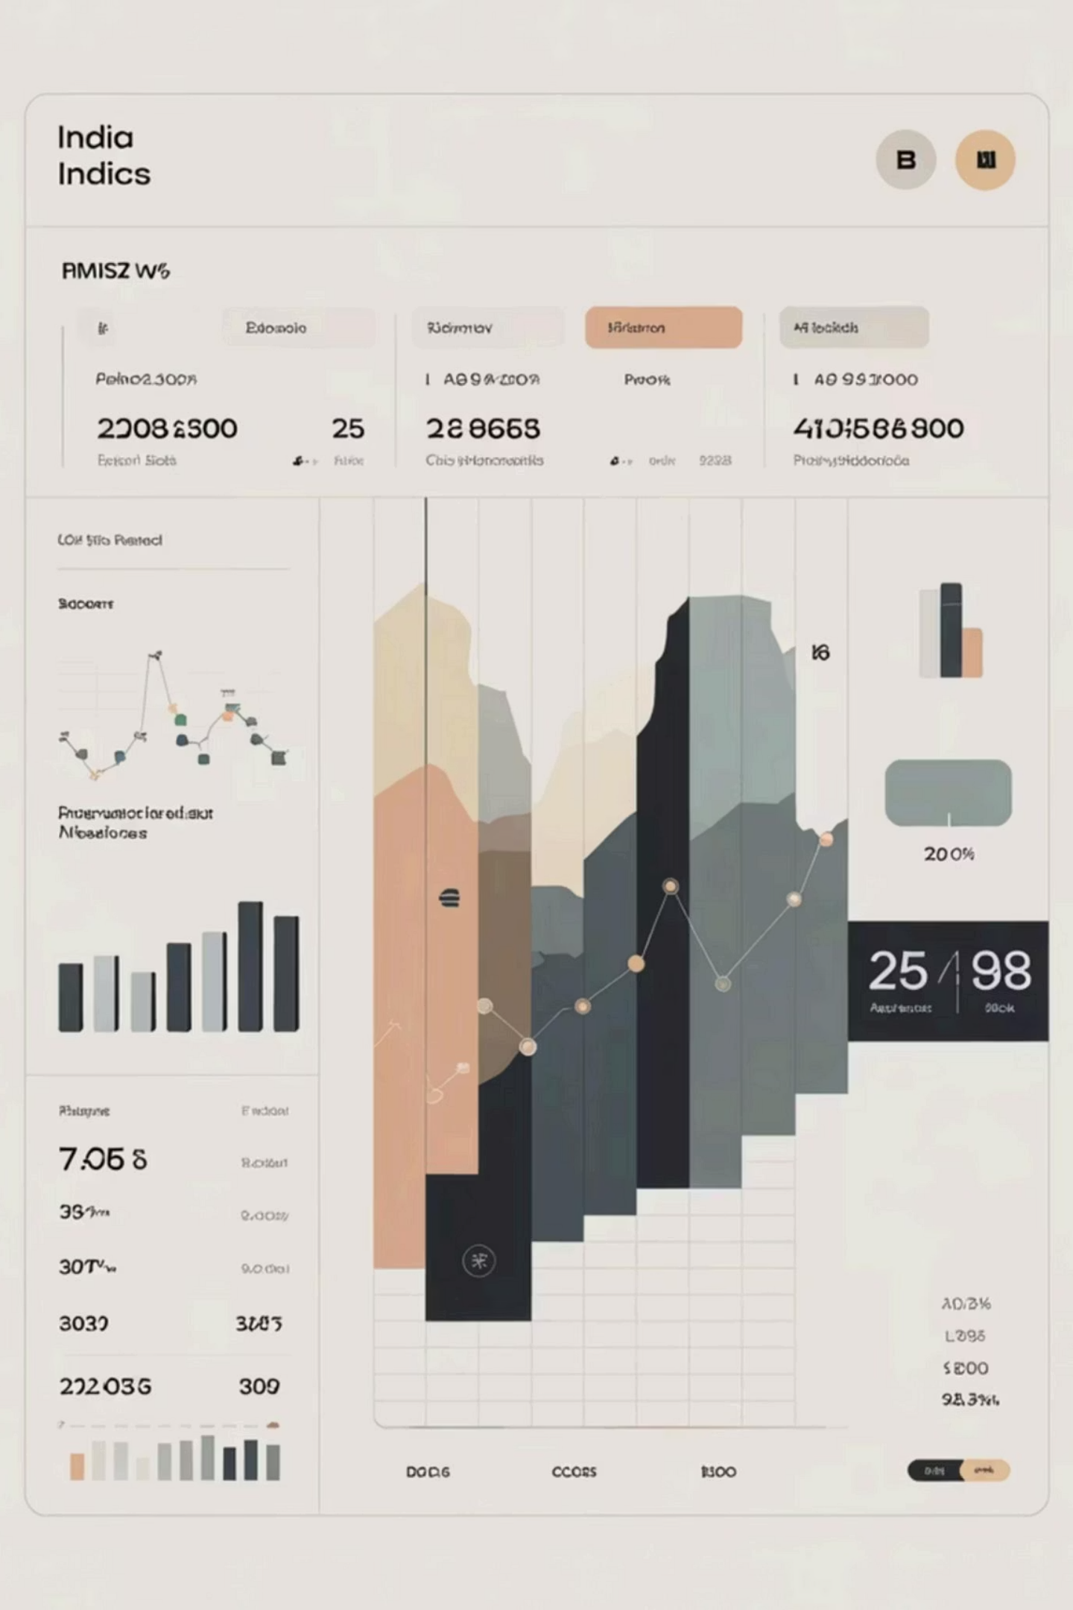
ElectViz
Multi-phase Indian election analysis with interactive Power BI dashboards

Slide 2

Data Foundation
Sources
Cleaning
Kaggle datasets with state, constituency, party, candidate, votes, electors, and phase mapping.
Removed nulls, trimmed text, enforced types, deduplicated on composite keys, filtered totals.
Normalization
Standardized state names, harmonized party abbreviations, split EVM vs postal votes.

Slide 3

Star Schema Architecture
Fact Table
Dimensions
Relationships
FactVotes at grain State–Constituency–Party–Phase with vote measures.
Date, State, Party, Candidate, Phase with surrogate integer keys for stable joins.
One-to-many from dimensions to FactVotes; active on StateKey and PhaseKey.

Slide 4
DAX Measures & Calculations
Calculated Columns
Core Measures
Margin
Total Difference
Total states in phase
Total EVM Votes Counted
VoteType (EVM/Postal)
Total Constituencies
CleanParty for grouping
Top N Parties by Votes

Slide 5









National Overview Dashboard
Total States
Aggregate across all phases
Constituencies
Complete constituency count
Candidates
Total candidates nationwide
Vote Share
Party distribution by votes

Slide 6
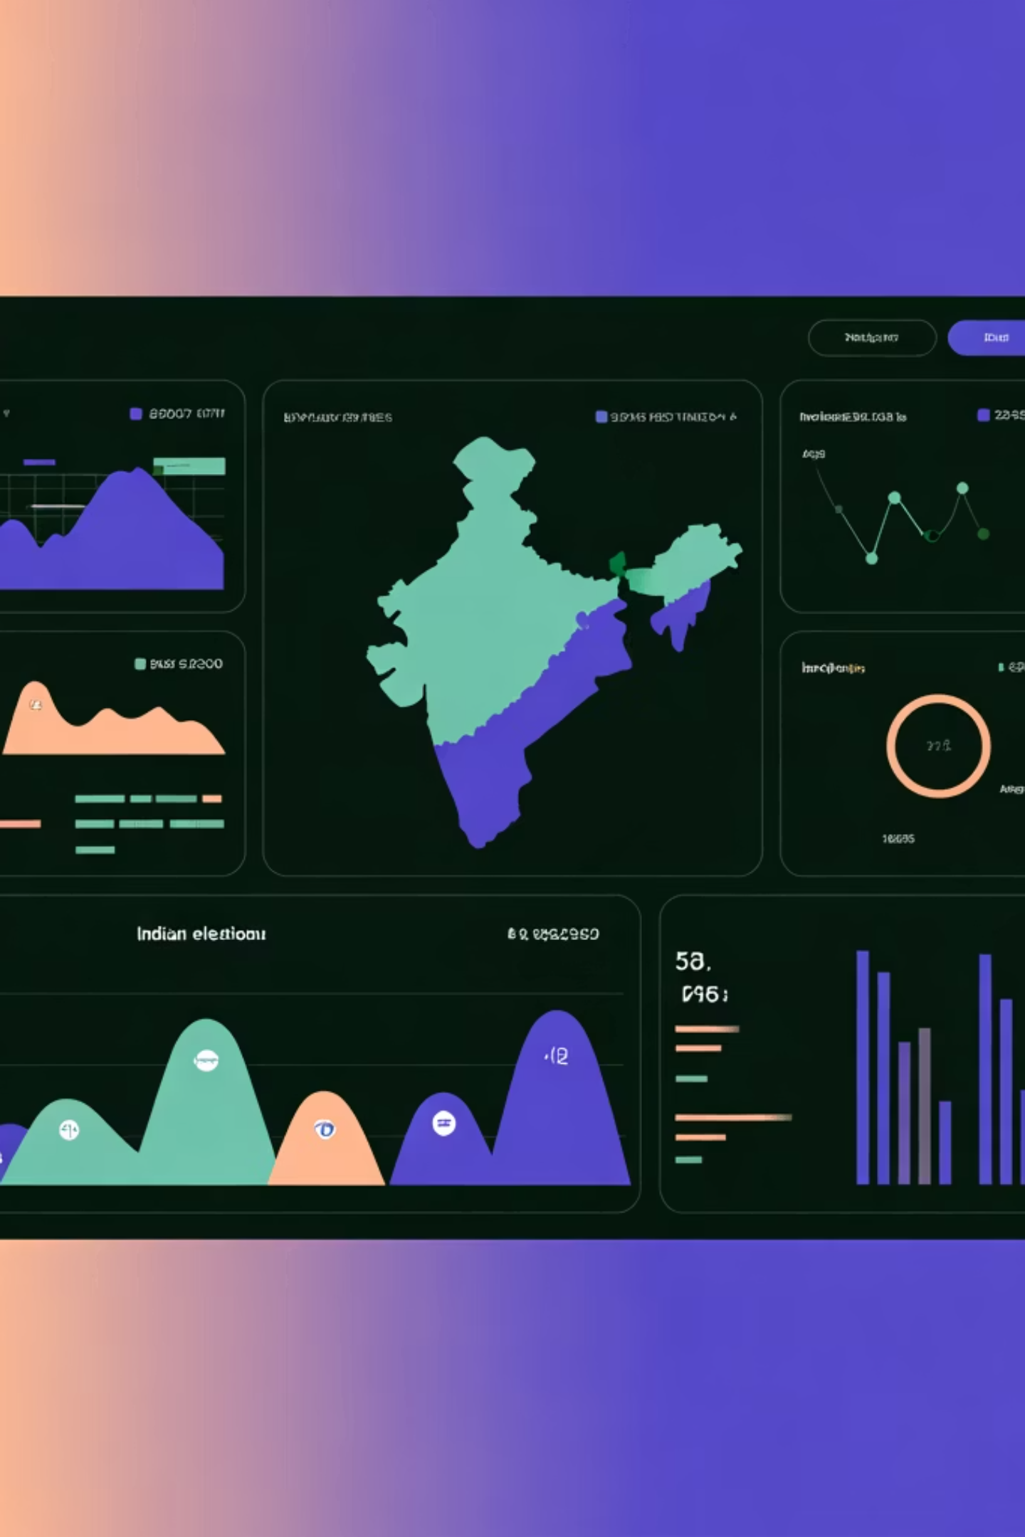
Dashboard Features & Insights
Visualizations
Key Highlights
Donut for party vote share
BJP and INC at top
Bar for top parties
Independents visible
Treemap for votes by state
Regional parties in distribution
Slicers for State, Party, Constituency
Drill-through to state/phase

Slide 7








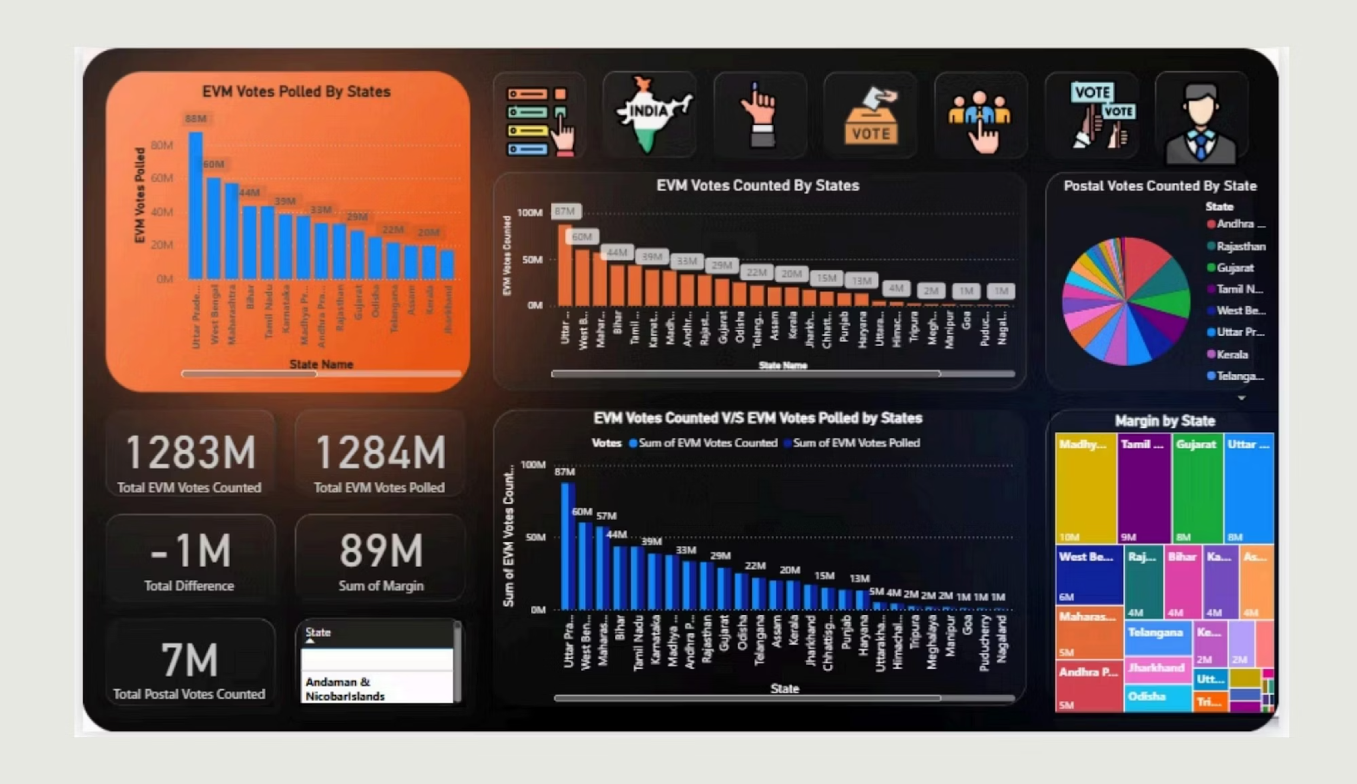
Counting & Margins Dashboard
EVM Votes
Postal Votes
Polled vs counted totals and differences by state.
Distribution across constituencies and states.
Operational Signal
Margin Analysis
Identifies states with large deltas and competitive margins.
Victory margins by state with heat and category bars.

Slide 8
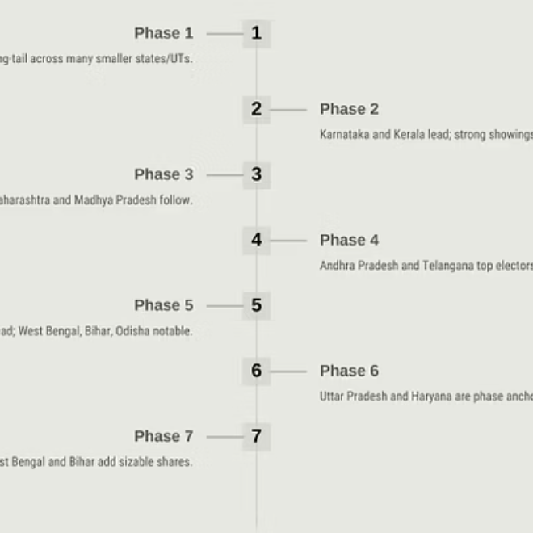
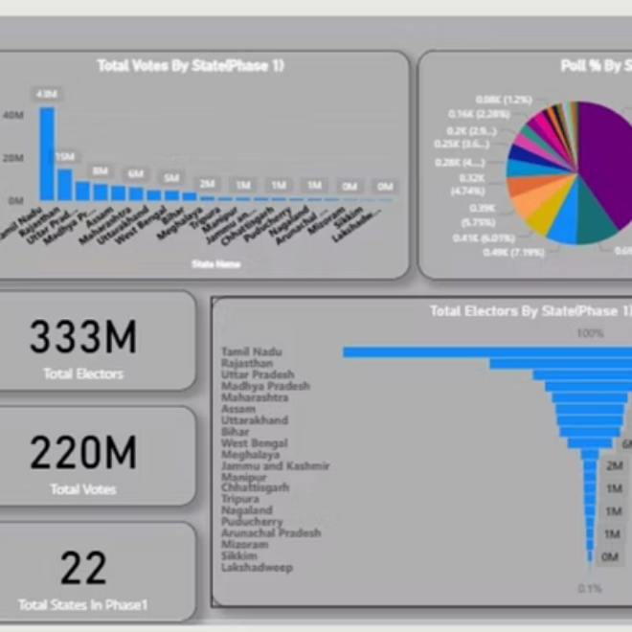
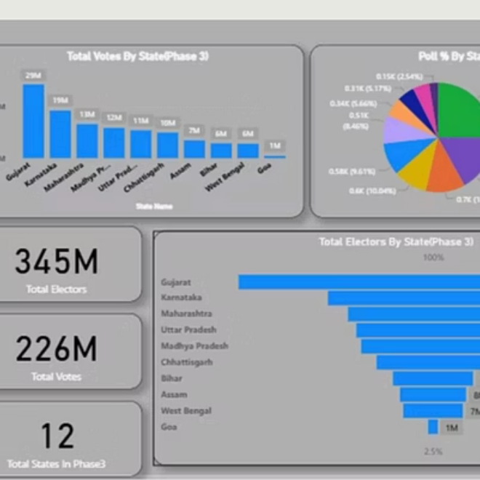
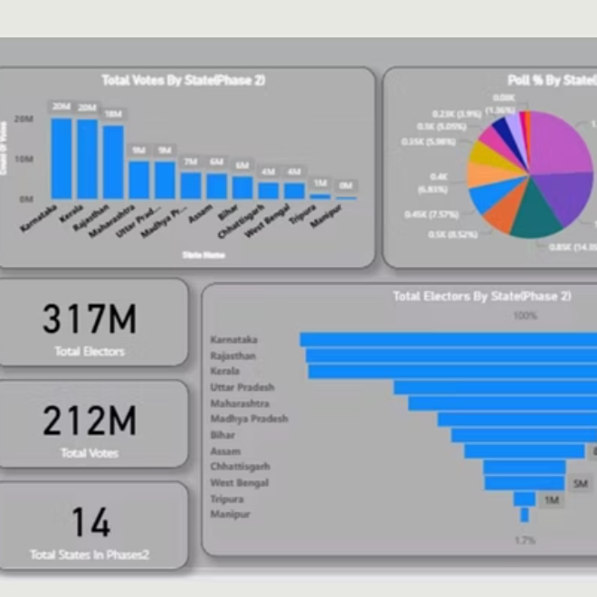
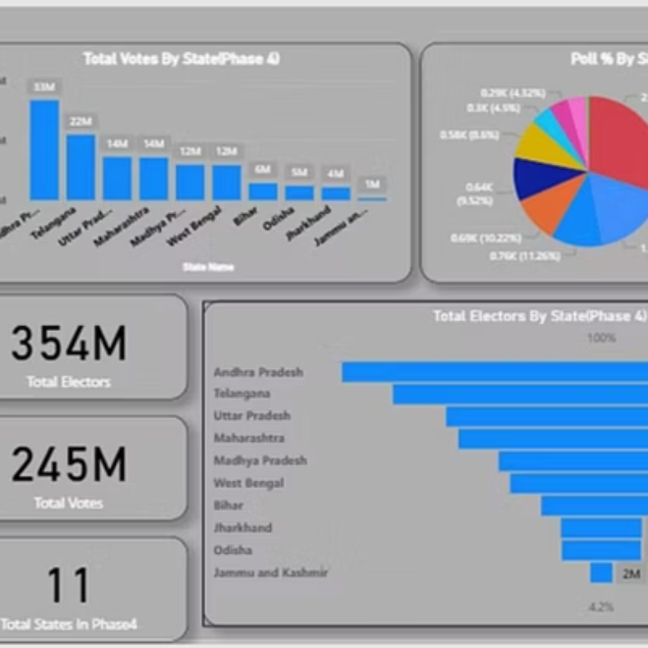
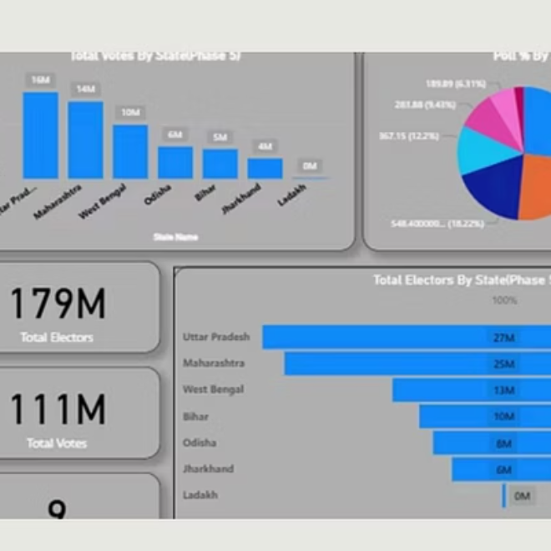
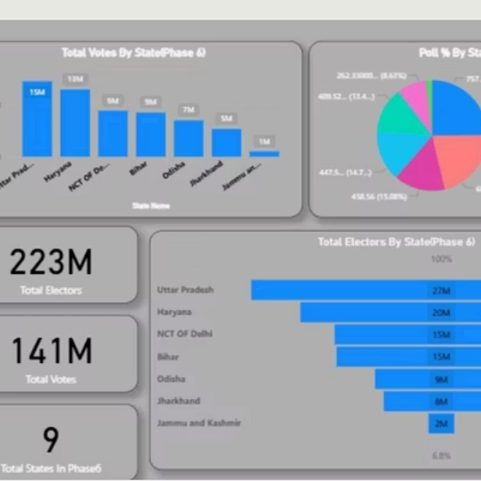
Phase-by-Phase Breakdown
Seven phase snapshots showing electors, votes, states, and turnout distribution.

Slide 9

Key Insights
1
Turnout Dynamics
Phases with UP, TN, AP/Telangana lift national totals; turnout varies meaningfully by phase state mix.
2
State Contribution
Small set of large states (UP, MH, TN, AP/TG, WB) drive majority of votes; dashboards quantify phase-wise share.
3
Operational Signal
EVM polled vs counted gaps and postal patterns vary by state; margin distribution pinpoints competitive states.
4
Party Landscape
Top-6 parties evident nationally; treemap reveals regional dominance and long-tail parties' contributions.

Slide 10

Conclusion & Next Steps
Deliverables
Future Enhancements
Two dashboards (national and counting/margins)
Constituency-level maps
Seat conversion analysis
Seven phase pages
Anomaly detection
Reusable DAX measures
Automated refresh pipelines
Outcome: Transparent, phase-aware election analytics enabling fast insights into turnout, state contributions, counting progress, and competitiveness for media, academia, and decision support.

